Slide 1
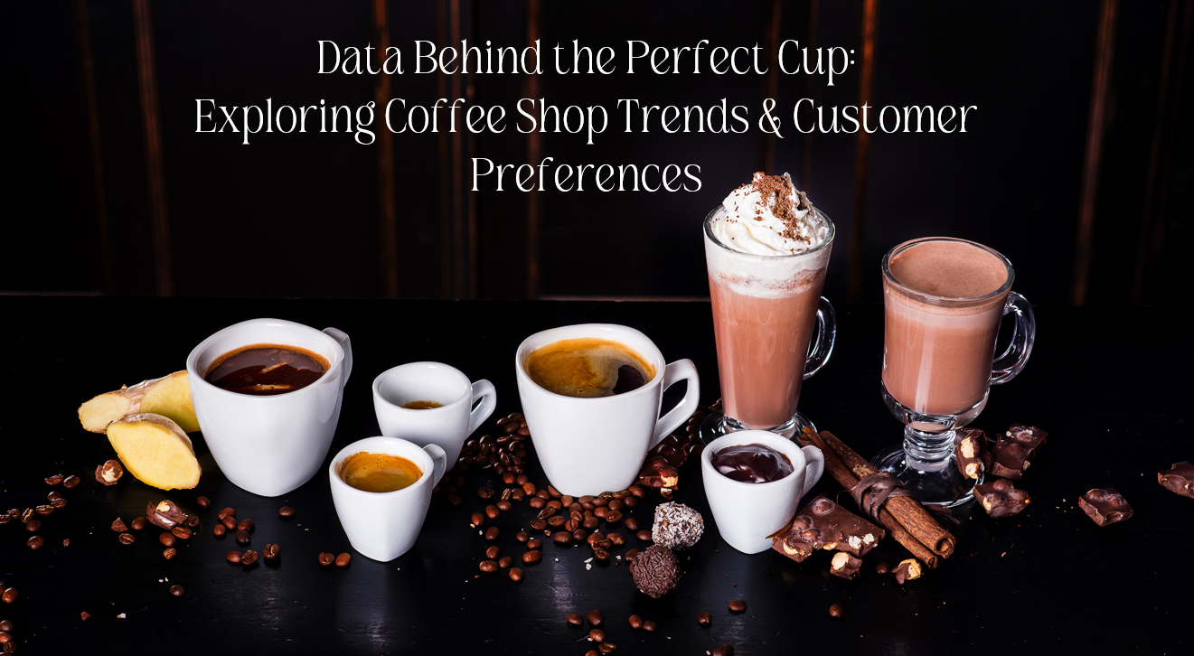
Notes:
We are presenting our project on analyzing popular beverage and snack choices in coffee shops, along with insights into customer satisfaction and visit frequency patterns.

Slide 2
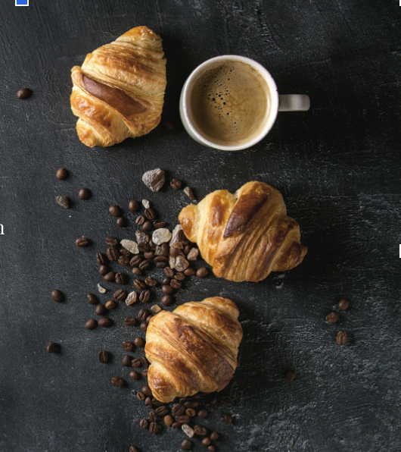
Group 6 - Project 1
Amy Slaton
Christian Molina
Jade Russell
Lavenya Ammu Mohanasundaram
Saniya Kulkarni
Notes:
Each group member, contributed by examining data from Yelp reviews of coffee shops to answer their perspective question. Through this project, we aimed to uncover trends that may help coffee shops optimize their offerings for customer satisfaction and higher ratings

Slide 3

Question 1: Most Popular Beverages & Snacks for Coffee Shops
Notes:
Amy
The objective for Question 1 was to identify the most popular beverages and snacks based on customer reviews and sales data. This was achieved by analyzing mentions and ratings from two datasets containing customer reviews and sales information.
To address this, I used keyword extraction by utilizing a helper function, ‘find_keywords’ to identify mentions of popular beverages and snacks. I then calculated the average star ratings for each product to assess customer satisfaction. Frequency counts were obtained by utilizing ‘value_counts() and the average ratings were calculated using ‘grouby()’ and ‘mean()’ functions.
The visualizations I used include word clouds and treemaps, which will be reviewed for each topic in the following slides.

Slide 4
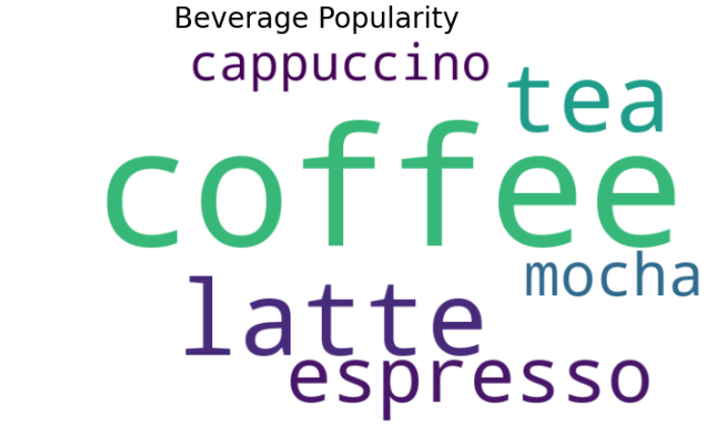
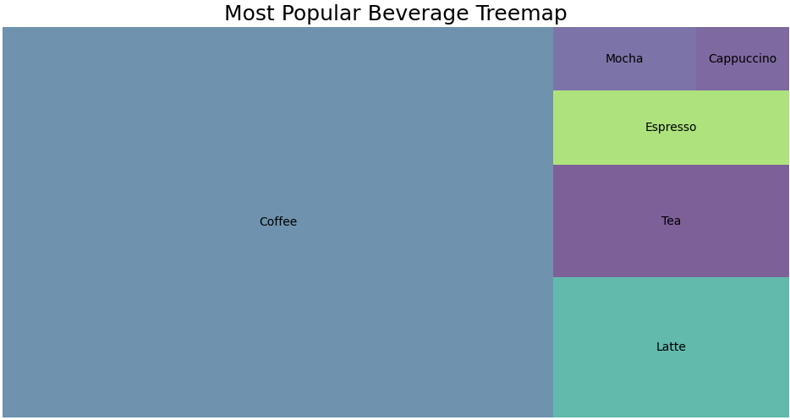
Most Mentioned:
Coffee: 9,698
Latte: 1,493
Tea: 1,193
Espresso: 792
Mocha: 405
Cappuccino: 246
Top Rated:
Croissant: 4.7 average
Cake: 4.6 average
Muffin: 4.3 average
Notes:
Amy
As shown in both visualizations of coffee shop beverages, coffee and lattes stand out as the most popular and highest-rated options according to customer feedback.
The word cloud visually represents the frequency of mentions, with the size of each word indicating its popularity.
The treemap displays each beverage as a block, with block size reflecting the number of mentions in reviews. This provides a clear visual of each beverage’s popularity based on customer interest.

Slide 5
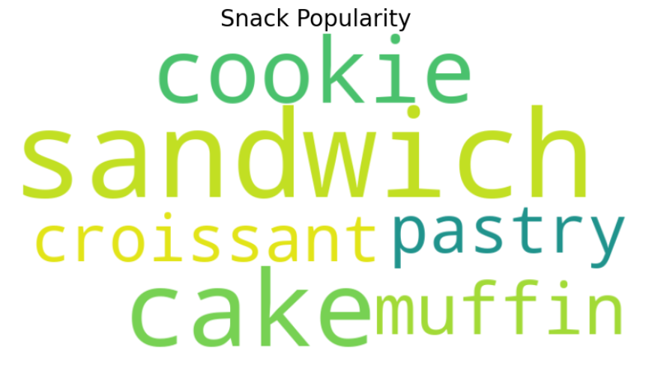
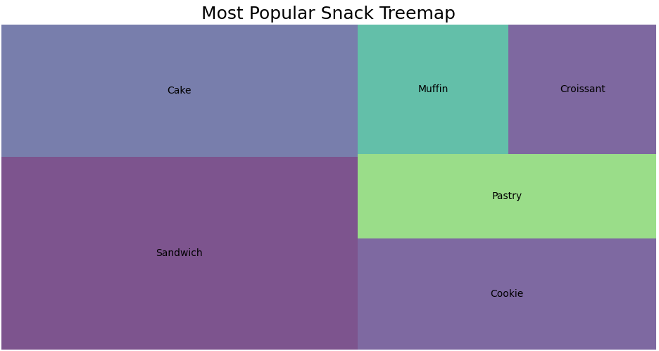
Most Mentioned:
Sandwich: 428
Cake: 293
Cookie: 207
Pastry: 157
Top Rated:
Croissant: 4.7 average
Cake: 4.6 average
Muffin: 4.3 average
Notes:
Amy
As with the beverages analyzed through the 2 datasets, this wordcloud identifies the popularity of each snack based on the visualized wording size, and the treemap based on the block size which represents the snack’s popularity.
Overall, the data analysis for question 1, revealed that while sandwiches are the most frequently mentioned snack, croissants and cakes receive higher customer ratings. This suggests that coffee shops might benefit from focusing on high-quality baked goods in addition to offering popular beverages like coffee and lattes, potentially increasing customer satisfaction and profits.

Slide 6
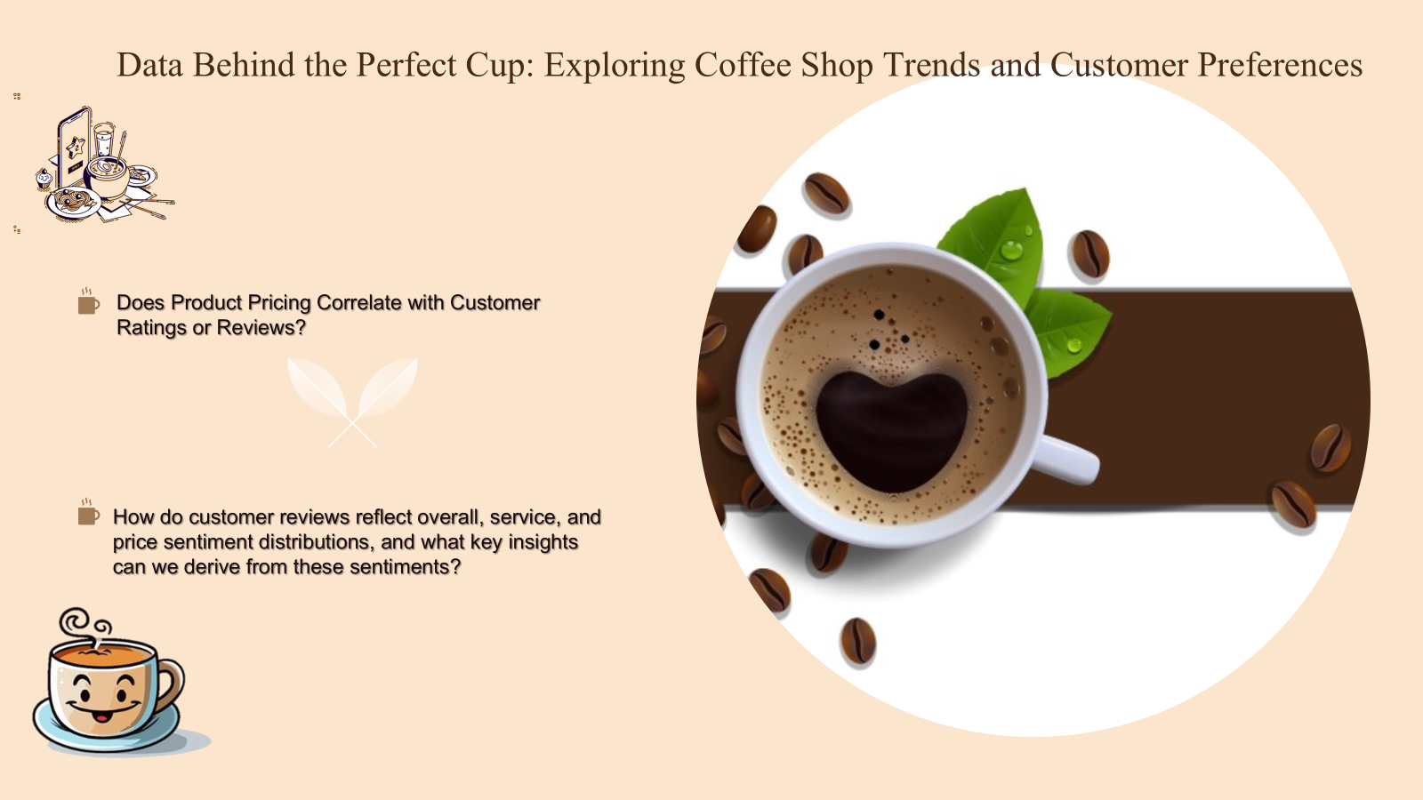
Notes:
Lavenya

Slide 7
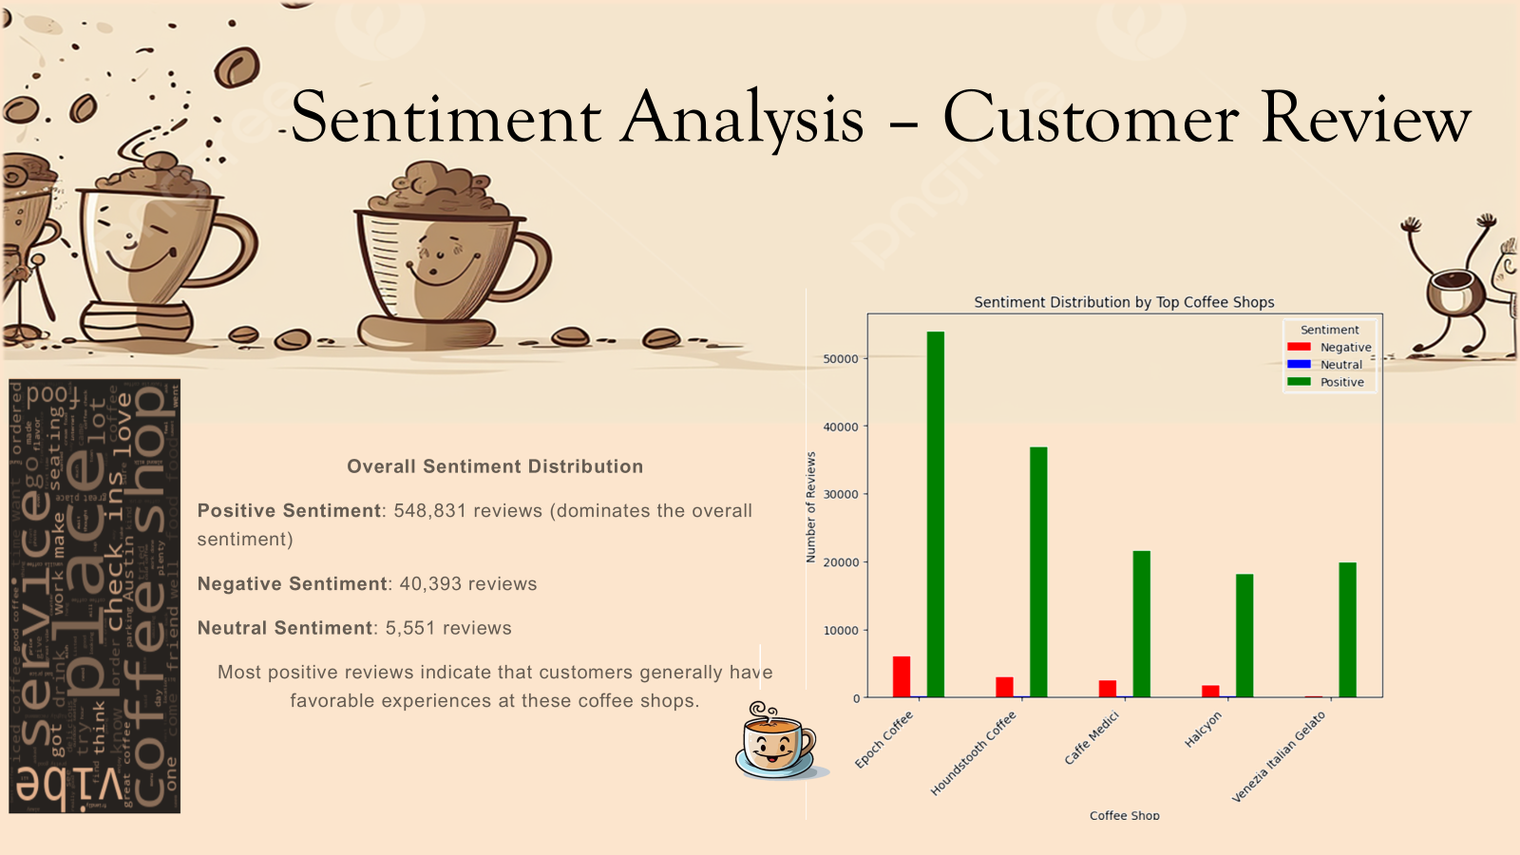
Notes:
Lavenya

Slide 8
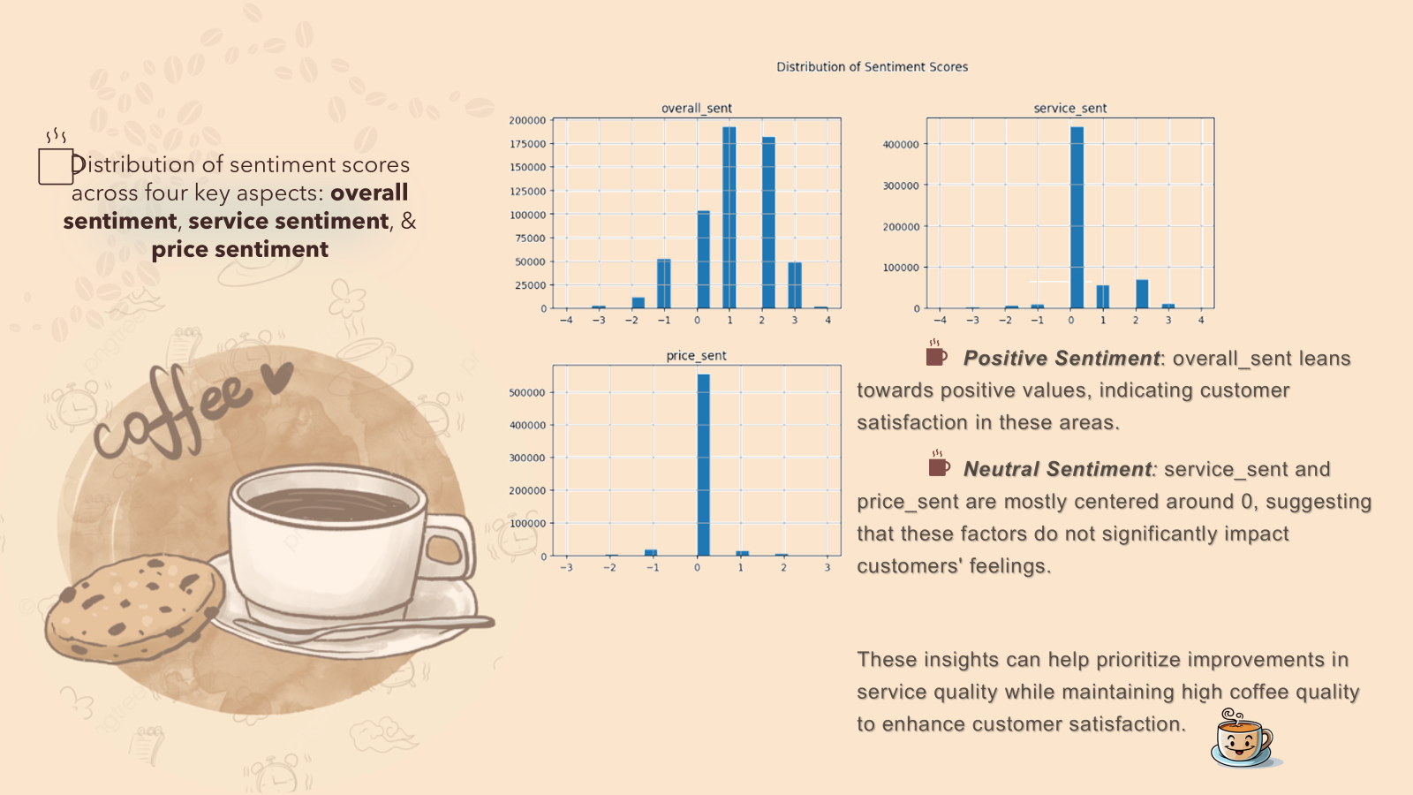
Notes:
Lavenya

Slide 9
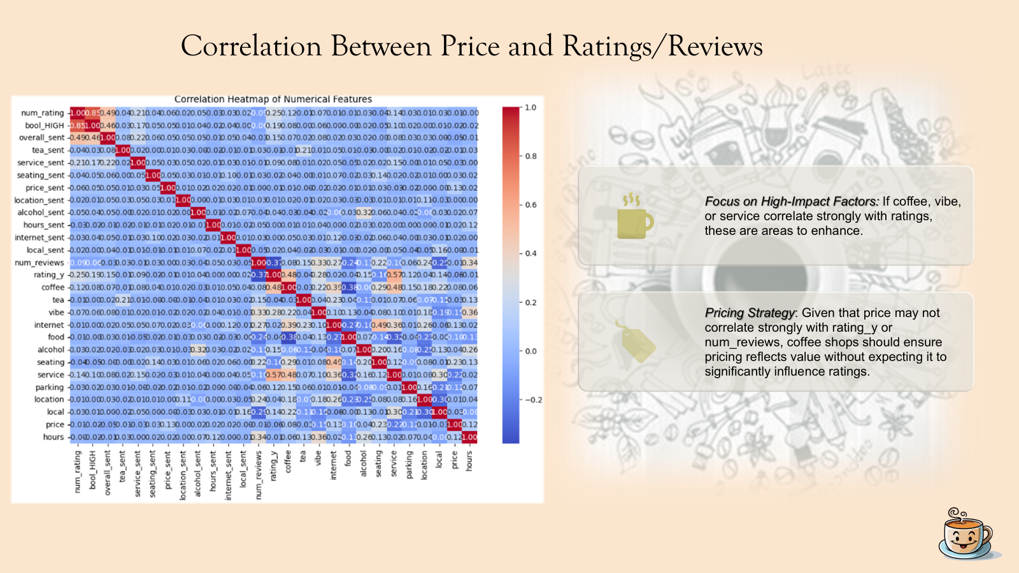
Notes:
Lavenya

Slide 10
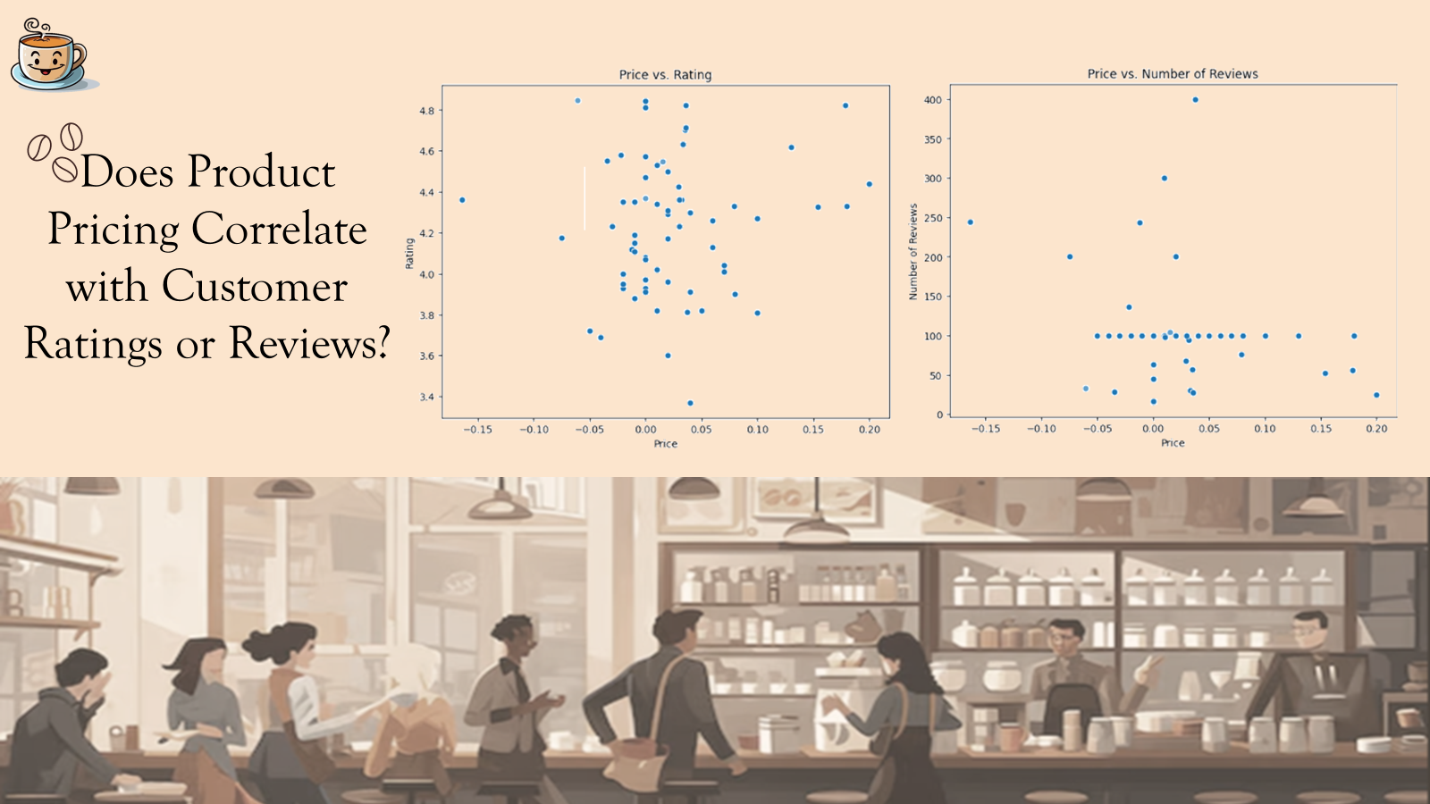
Notes:
Lavenya

Slide 11
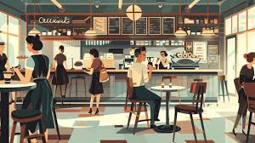

Is there a correlation between how often people visit a coffee shop (visit frequency) and its customer rating?
Assumptions:
Number of Reviews = Unique reviews
Number of Reviews= Frequency of visits at a Coffee Shop
Average Star Ratings have been utilized

Slide 12
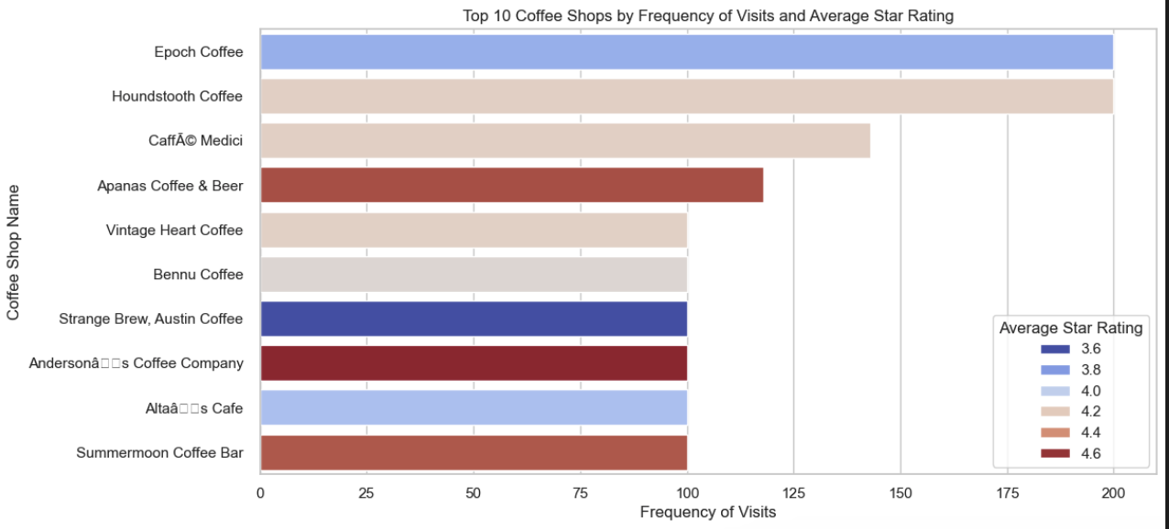
Top 10 Coffee Shops

Slide 13
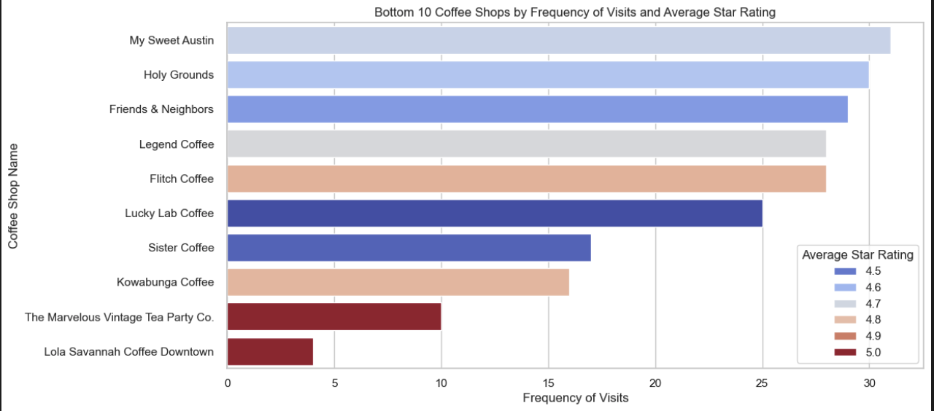
Bottom 10 Coffee Shops

Slide 14
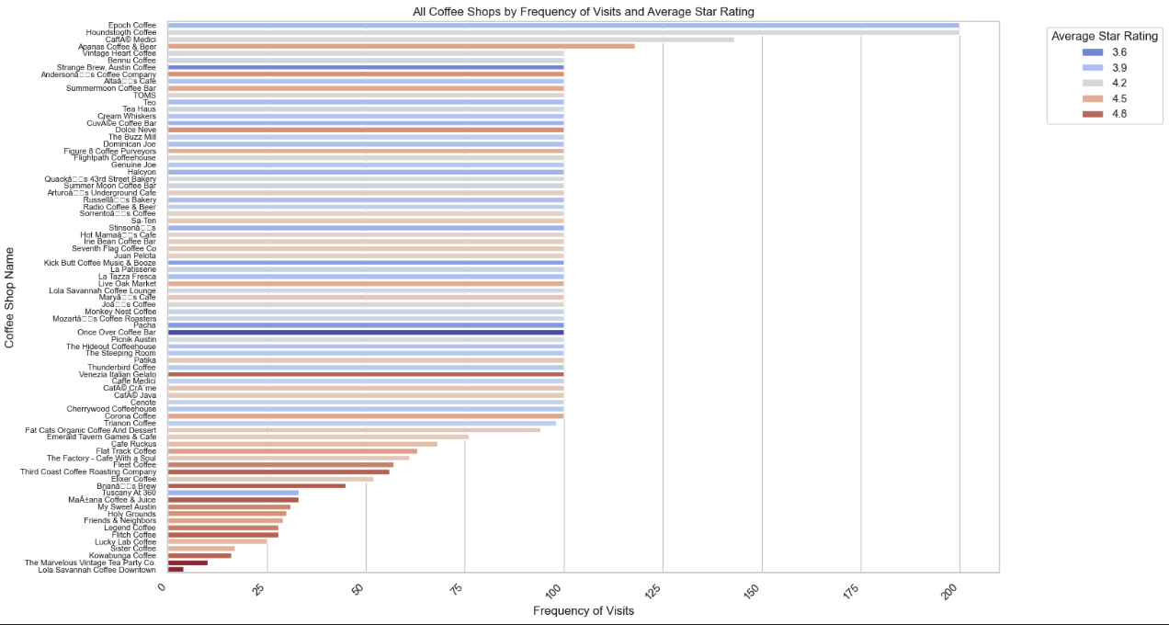
ALL Coffee Shops

Slide 15
Analysis Results:
Top 10 Coffee Shops: More frequency of visits leads to more critical rating/reviews by visitors
Bottom 10 Coffee Shops: Less frequency of visits lead to high ratings, but aren’t reliable
Would not take negative/critical ratings very seriously as long as the rating is above 3.5 for popular coffee shops.
Would be mindful of the”review content” for least visited coffee shops even if the rating is >4.0

Slide 16
Can we find any other patterns that might make a customer happier?
We attempt to detect any anomalies in product sales/reviews such as sudden spikes in specific items or times of year
Using the Yelp reviews from coffee shops in Austin Texas we hope to further investigate the data behind the perfect cup and the secret to a 5 star experience
Notes:
Jades

Slide 17
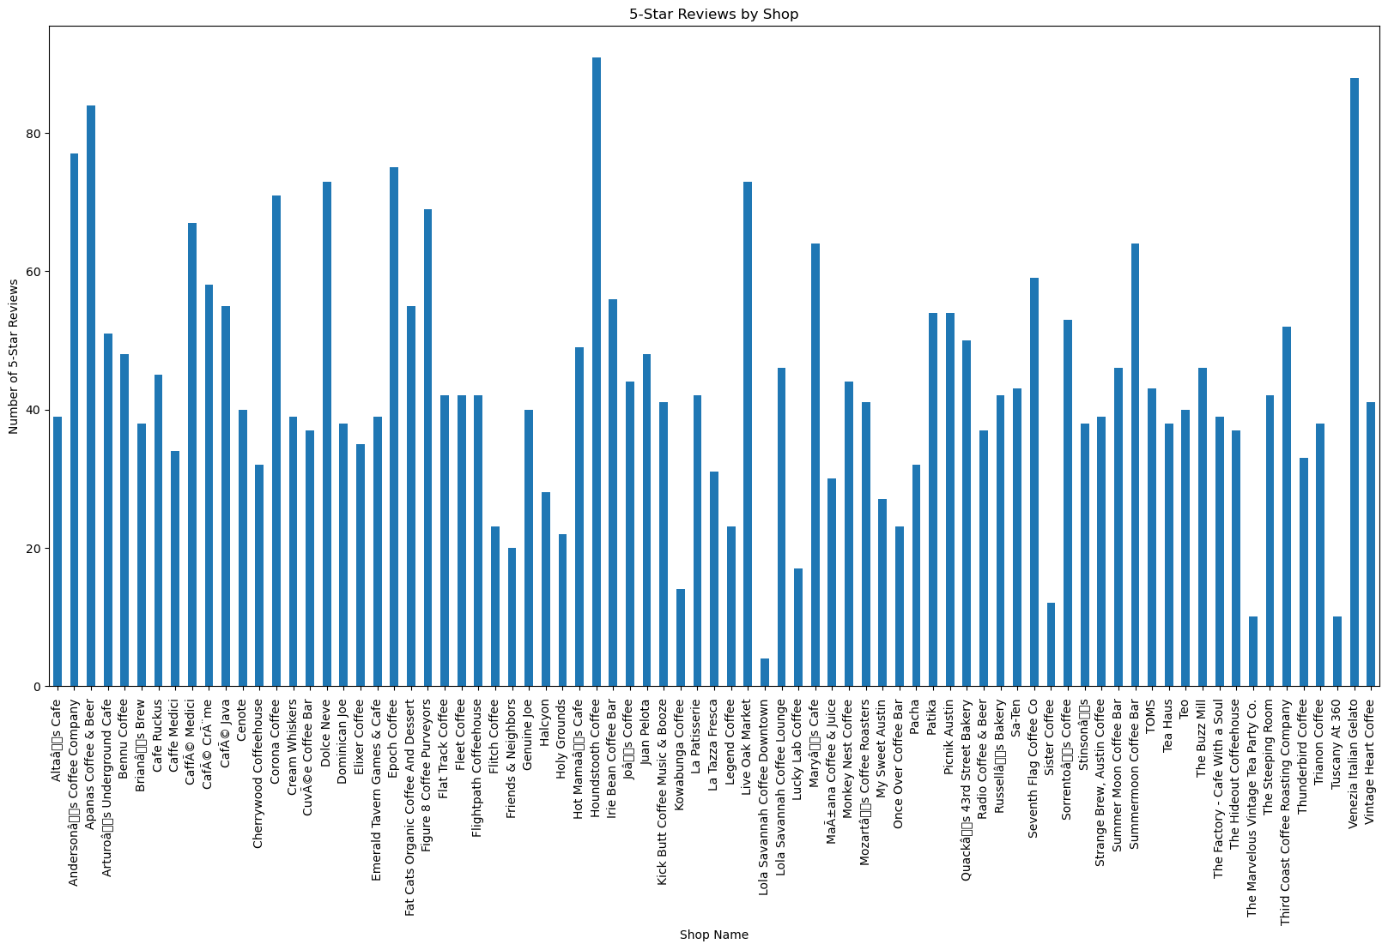
Looking at the Yelp dataset
Much too large with 79 shops
Interesting first look: Lola Savannah Coffee Downtown
Whereas
Houndstooth Coffee | 91
Venezia Italian Gelato | 88
Apanas Coffee & Beer | 84
Andersonâs Coffee Company | 77
Epoch Coffee | 75
Notes:
Lola Savannah Coffee Downtown first look, you would think that it is not thriving but the truth is, it only has 4 reviews and they’re all 5 stars this goes back to Saniya’s insight in popularity

Slide 18
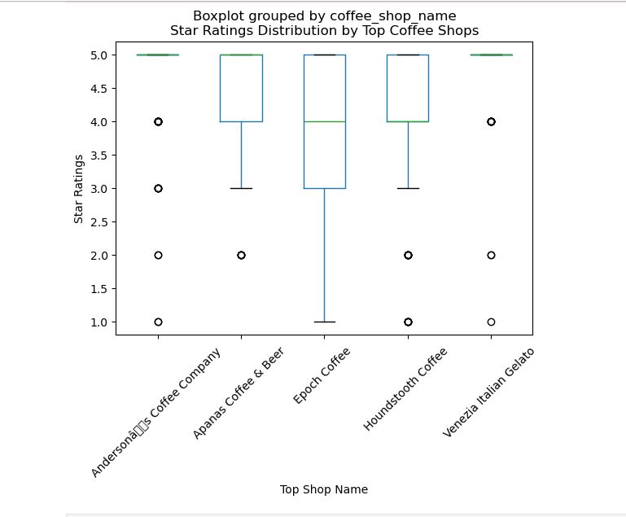
Further investigation:
The shops with the most 5 star ratings deep dive
Notes:
Andersons: local, oldershop, no buzzwords (back to amy’s slides), just mentions on the coffee itself being good and the beans being high quality
Apanas: Actually serves more than Coffee they also have beer, wine, juice, most the reviews mention the location being very cute, cozy cafe, ect. Meaning the customers love the location more than the specific items. Further research would be needed to conclude if ambiance effects customers taste
Epoch: As Saniya showed is one of the most visited, would explain the wider range of reviews. Mention being very busy, lot of reviewed focused on that aspect of the visit. Something called Mojo there that is highly rated. Positive for college student, mentions of space and wifi.
Houndstooth Coffee: ^ Delicious coffee, chai, cappuccino, highly curated tea selection. Out of all the shops this one focused more on the actual drinks as opposed to other factors. Call back to Lavenya’s positive
Venezia Italian Gelato: which is obviously manly a dessert shop. They have a coffee flavor. I would say this shop is skewing our data

Slide 19
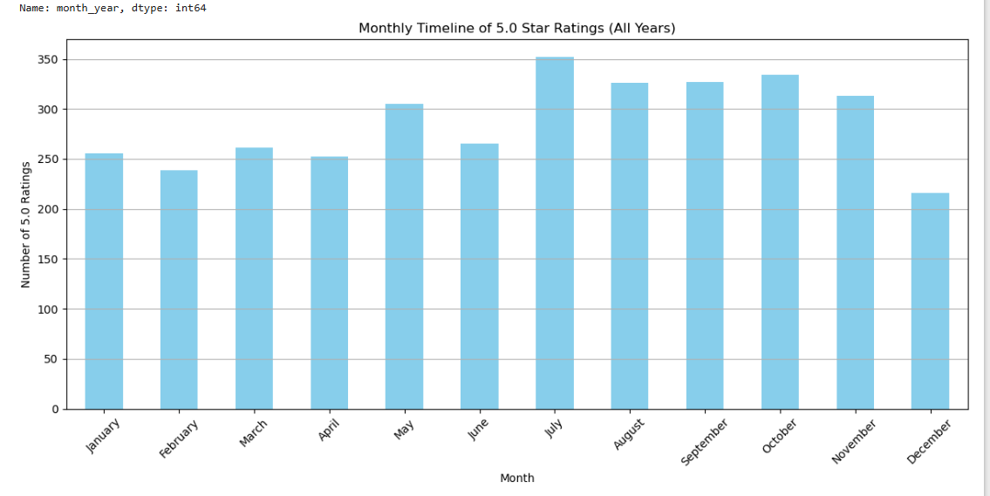
Can we draw conclusions from 5 star review to time of year?
According to Austin Yelp data:
Monthly Counts:
month
January 256
February 239
March 261
April 252
May 305
June 265
July 352
August 326
September 327
October 334
November 313
December 216
Notes:
I would have assumed around the holidays we would have a peak in more 5 star reviews “happiest time of the year” but as we can see, that is not the “happiest” time of the year,

Slide 20

Question:
How do product preferences vary across different regions?

Slide 21
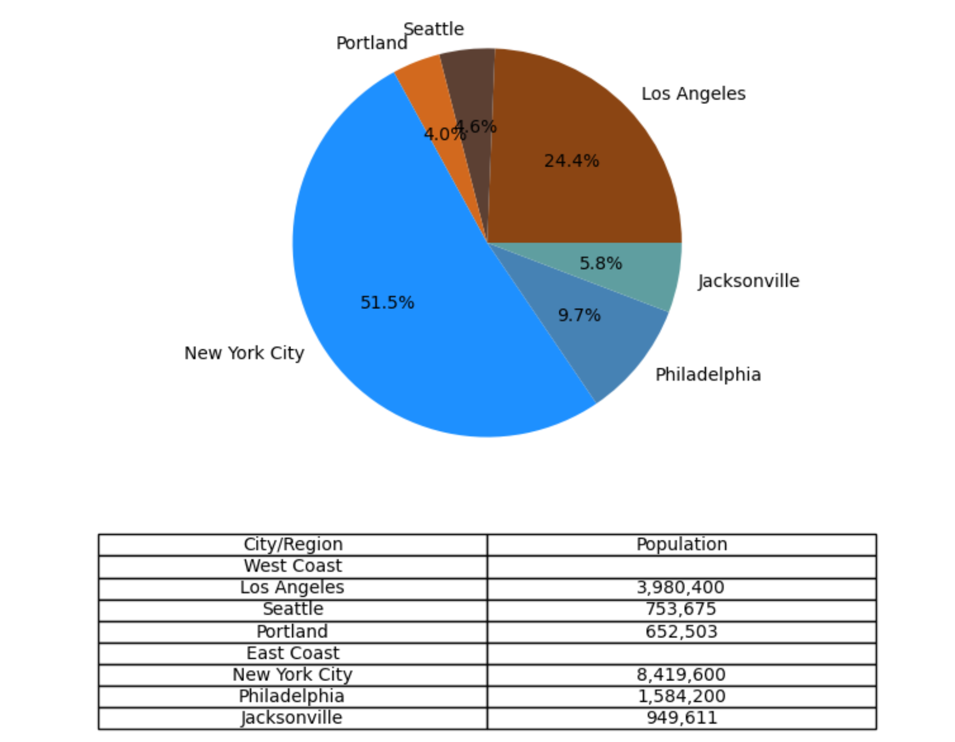
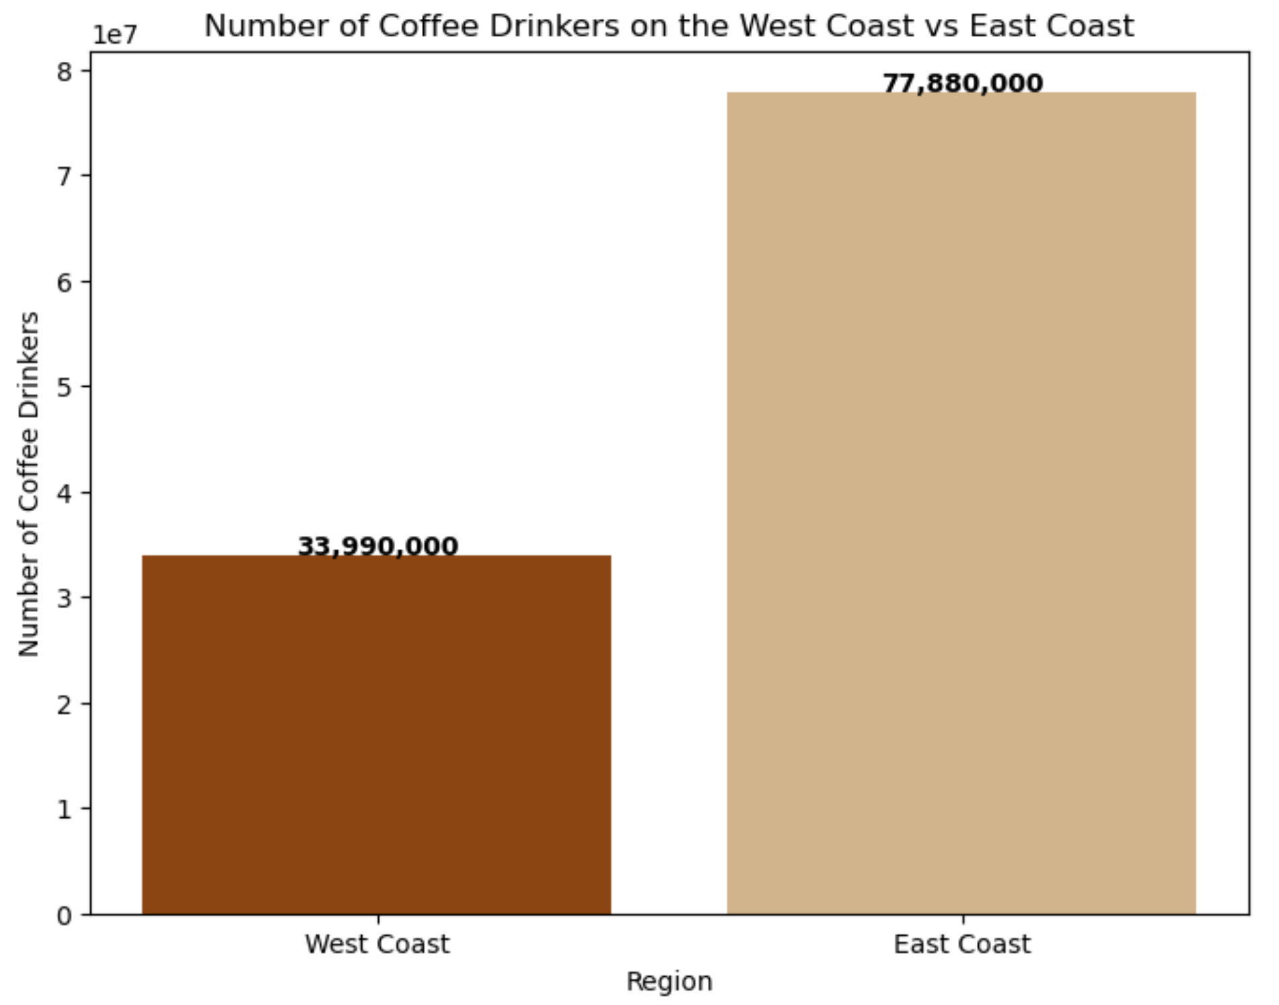
Population plays a role…

Slide 22
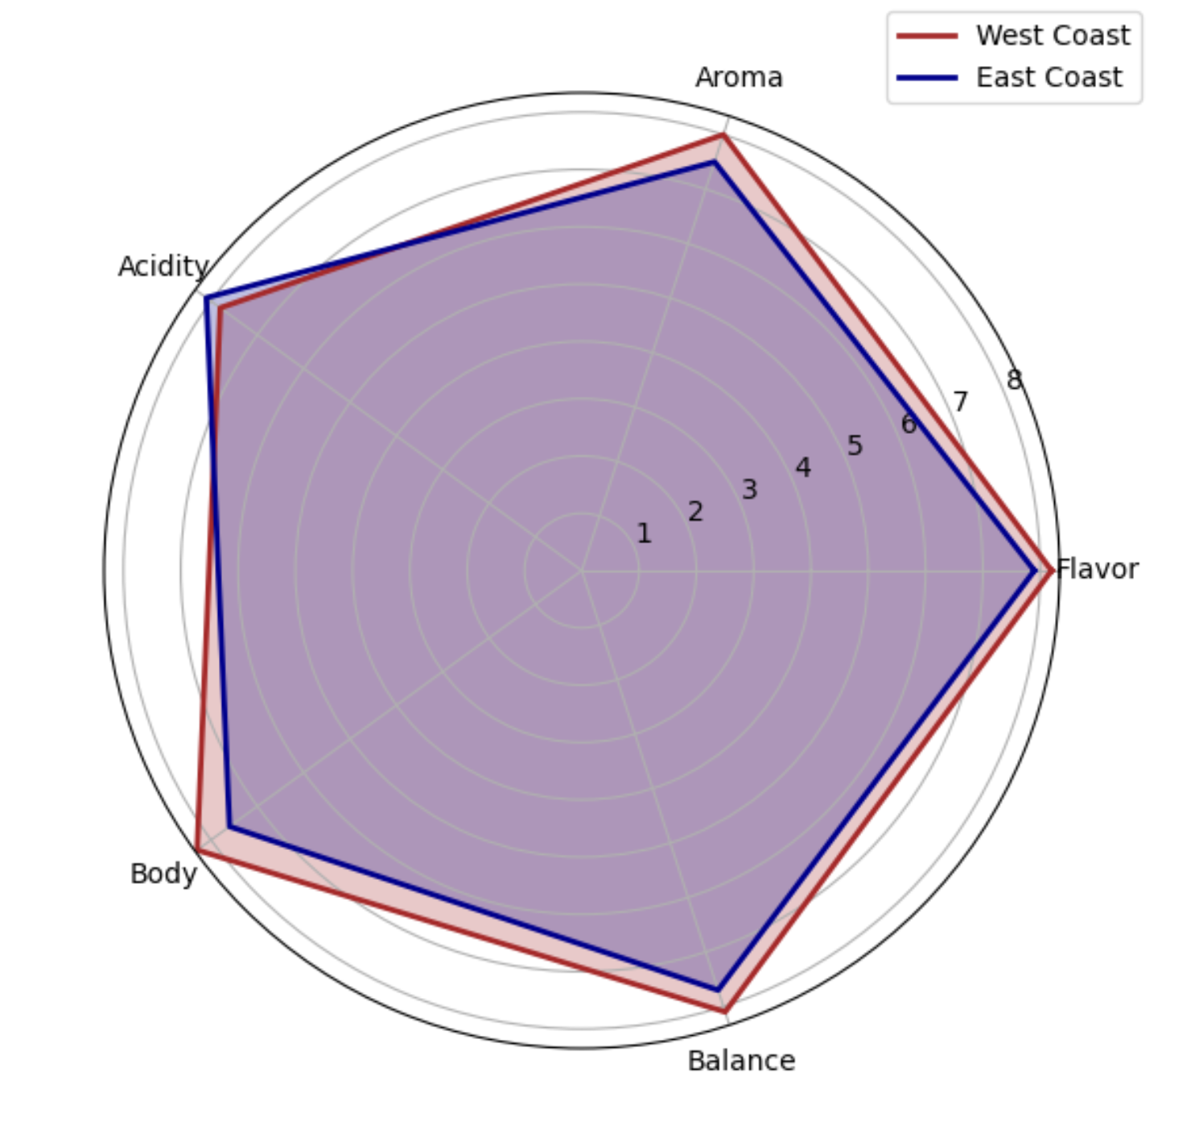
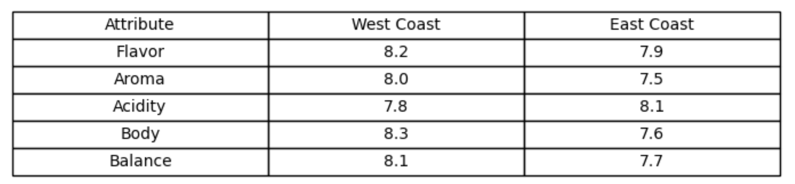
Coffee profile
Climate: Warmer regions may prefer cold brews or lighter profiles.
Example: Iced coffee on a hot summer day
Culture: Areas with a strong coffee culture, like the West Coast, consumers tend to be more knowledgeable of different flavor profiles and may seek out specific attributes.
Example: Hario V60, one of the most popular Japanese pour-over methods in specialty shops across the United States.

Slide 23
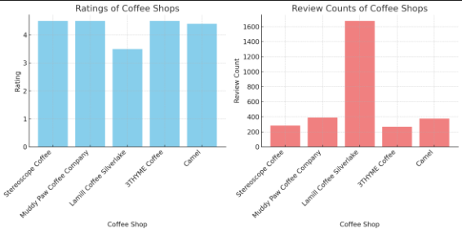
The money in your pocket!
Los Angeles

Slide 24
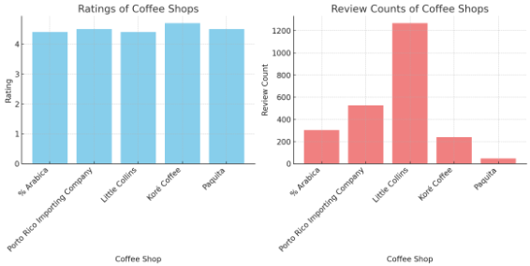
New York City

Slide 25


